Slide 1

Hospital Operations & Patient Flow Performance Dashboard
Power BI Project – End-to-End Analytics & Security (RLS)
Tools: Power BI | Power Query | DAX | RLS
Presented by:
Indhumathi S

Slide 2

Business Problem & Objectives
Hospital Challenges
Project Objectives
Access Control Gaps
Appointment Outcomes
Data Privacy Risks
Data Quality Issues
Data Silos
Doctor Performance Tracking
Patient Flow Visibility
Revenue Trend Analysis
Bottleneck Identification
Centralized Dashboard
Doctor & Specialization KPIs
Operational Monitoring
Patient Flow Analysis
Revenue Performance
Role-Based Access
Row-Level Security (RLS)
Secure Data Access
Tools & Techniques
DAX Measures
Data Modeling (Star Schema)
Power BI
Power Query (Append, Merge)
Row-Level Security (RLS)

Slide 3

Dataset Overview – Hospital Management (Public Dataset- Kaggle)
Tables Used:
Why multiple tables?
appointments.csv – appointment flow & status
patients.csv – patient details
doctors.csv – doctor & specialization
billing.csv – revenue & payment status
treatments.csv – treatment & cost
Real-world hospital systems use normalized data
Enables star schema modeling

Slide 4
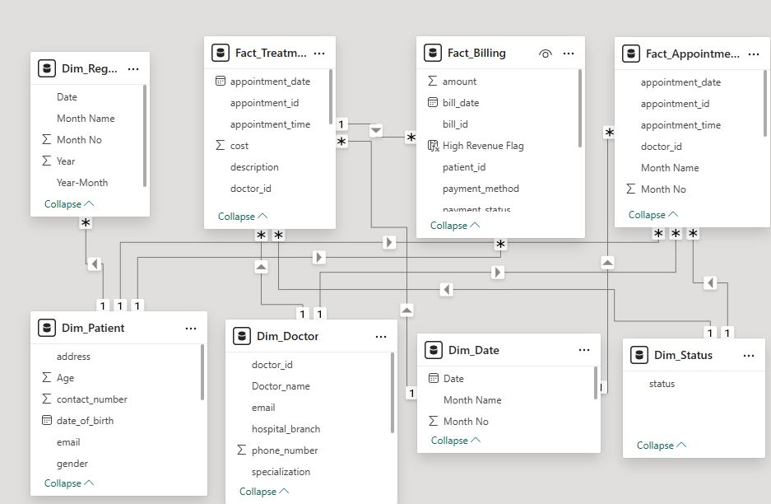
Data Model (Star Schema)
Content:
Dimensions:
Dim_Patient
Dim_Doctors
Dim_Date
Facts:
Fact_Appointments
Fact_Billing
Fact_Treatments
Why Star Schema?
Faster performance
Clean filtering
Required for accurate DAX & RLS

Slide 5
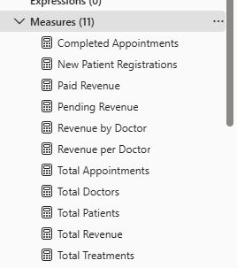
Key DAX Measures
Why DAX?
01
Business KPIs can’t be calculated directly from raw columns
Enables time analysis, performance metrics
Purpose
KPI Creation,
Performance Tracking,
Time Analysis, Reusable Metrics,
Consistent Reporting
02

Slide 6
Key DAX Measures
Revenue per Doctor: Shows the average revenue contribution of each doctor.
Paid Revenue : Calculates the total revenue received from completed payments.
Completed Appointments :Counts completed appointments to measure service performance.
Pending Revenue : Tracks total unpaid revenue for financial monitoring.
Total Patients :Calculates the total number of unique patients.
Total Treatments : Shows the total number of treatments performed to measure service activity.
Total Revenue : Calculates the total revenue generated from all billing transactions.
Pending Revenue : Measures revenue contribution by each doctor.
Total Doctors : Shows the total number of unique doctors to measure available medical resources.
New Patient Registrations :
Tracks new patient registrations over time.
Total Appointments :Calculates the total number of appointments to monitor hospital service volume.

Slide 7

Data Preparation (Power Query Editor)
Used Transformations:
Why this is important:
Append & Merge
Date functions (Year, Month)
Text functions (Full Name)
Data type corrections
Removed orphan records (to fix blanks)
Clean data → correct visuals
Avoids relationship & RLS issues

Slide 8

Role-Based Access Control (RLS) – Doctors & Patients
Roles Implemented
Doctor Access (10 users)
Patient Access (51 users)
Security Design
Role-Based Access
User-Level Filtering
Data Privacy
Secure Access Control
Implementation
Dynamic RLS (Email-based)
DAX Filters
Power BI Service Roles

Slide 9
Executive Overview – Hospital Performance
Overview page
📊 KPIs (Cards)
📈 Visuals Used
🎛 Slicers
Total Appointments
Purpose: Shows overall patient demand and hospital workload.
Total Revenue (by Doctor)
Purpose: Measures revenue performance driven by doctors.
Total Patients
Purpose: Indicates active patient base.
Total Doctors
Purpose: Shows available medical capacity
Pie Chart – Appointment Status Distribution
Purpose:
Compares Completed vs Cancelled vs Pending appointments
Highlights operational issues (cancellations, delays)
Clustered Column Chart – Monthly Appointment Trend
Purpose:
Shows month-wise appointment volume
Identifies peak and low-demand periods
Helps in staffing and scheduling
Line Chart – Monthly Revenue Performance
Purpose:
Analyzes revenue trend over time
Identifies growth and decline periods
Supports financial planning and performance tracking.
Year & Month – Analyze performance by year & month
Specialization – Compare departments
Patient Name – Drill down to individual patient view (Admin only)
Status – Filter by appointment status (Completed / Cancelled / Pending

Slide 10
Patient Flow & Treatment Analysise Overview – Hospital Performance
Main page
📈 Visuals Used
🎛 Slicers
Decomposition Tree – Revenue Breakdown by Doctor, Specialization & Branch
Purpose:
Root-cause analysis
Revenue drivers
Performance drill-down
Decision support
Scatter Chart – Doctor Performance: Volume vs Revenue
Purpose:
Performance comparison
Volume vs revenue
High performers
Efficiency gaps
Area Chart – Monthly Patient Registrations
Purpose:
Patient growth
Registration trend
Peak periods
Demand forecast
Clustered Bar Chart – Treatments by Type
Purpose:
Treatment volume
Demand comparison
Resource planning
Portfolio optimization
Clustered Column Chart – Appointments by Reason for Visit
Purpose:
Demand patterns
Visit category trends
Service planning
Capacity allocation
Line Chart – Monthly Treatments Trend
Purpose:
Trend analysis
Seasonal patterns
Growth/decline
Capacity forecasting
Date (Year / Month)
Time filtering
Trend comparison
Seasonality
Doctor Specialization
Compare departments
Workload comparison
Demand focus
Patient Name –
Drill down to individual patient view (Admin only)
Appointment Status
Filter by appointment status (Completed / Cancelled / Pending
Appointment Status
Location filter
Branch comparison

Slide 11
Doctor & Revenue Performance
Report Page
📈 Visuals Used
🎛 Slicers
Matrix – Revenue by Specialization & Year
Purpose:
Specialty revenue
Performance tracking
Stacked Bar – Top 5 Doctors by Appointments
Purpose:
Top performers
Volume ranking
Workload distribution
Pie – Revenue by Specialization
Purpose:
Top performers
Volume ranking
Workload distribution
Funnel – Revenue by Doctor
Purpose:
Revenue ranking
Drop-off analysis
Performance funnel
Clustered Column – Appointments by Doctor
Purpose:
Doctor workload
Volume comparison
Capacity planning
Year:
Time filter | YoY view
(Year over Year)
Hospital Branch:
Location filter | Branch compare
Month Name:
Seasonal view | Trend focus

Slide 12

Doctor & Revenue Performance
Drill through Page
Card – Total Revenue
Purpose
Revenue snapshot
Financial KPI
Performance summary
Card – Total Treatments
Purpose
Revenue snapshot
Financial KPI
Performance summary
Table – Patient-wise Revenue Details
Purpose
Revenue drill-down
Patient-level view
Audit suppor

Slide 13




Why This Project? | Value | Impact
✅ Why Choose This Project?
⚠ Problem Addressed
🚀 Improvements Achieved
👥 Who Benefits?
Scattered operational data
No doctor performance visibility
Limited revenue insights
Manual reporting delays
Centralized reporting
Automated KPIs & trends
Role-based secure access (RLS)
Faster, data-driven decisions
Hospital Management
Operations Team
Doctors (performance view)
Admin & Finance
Real-world hospital analytics use case
Multiple fact tables & data modeling
Practical RLS implementation
Business-focused dashboards

Slide 14
THANK YOU
Open for questions & feedback

